Slide 1
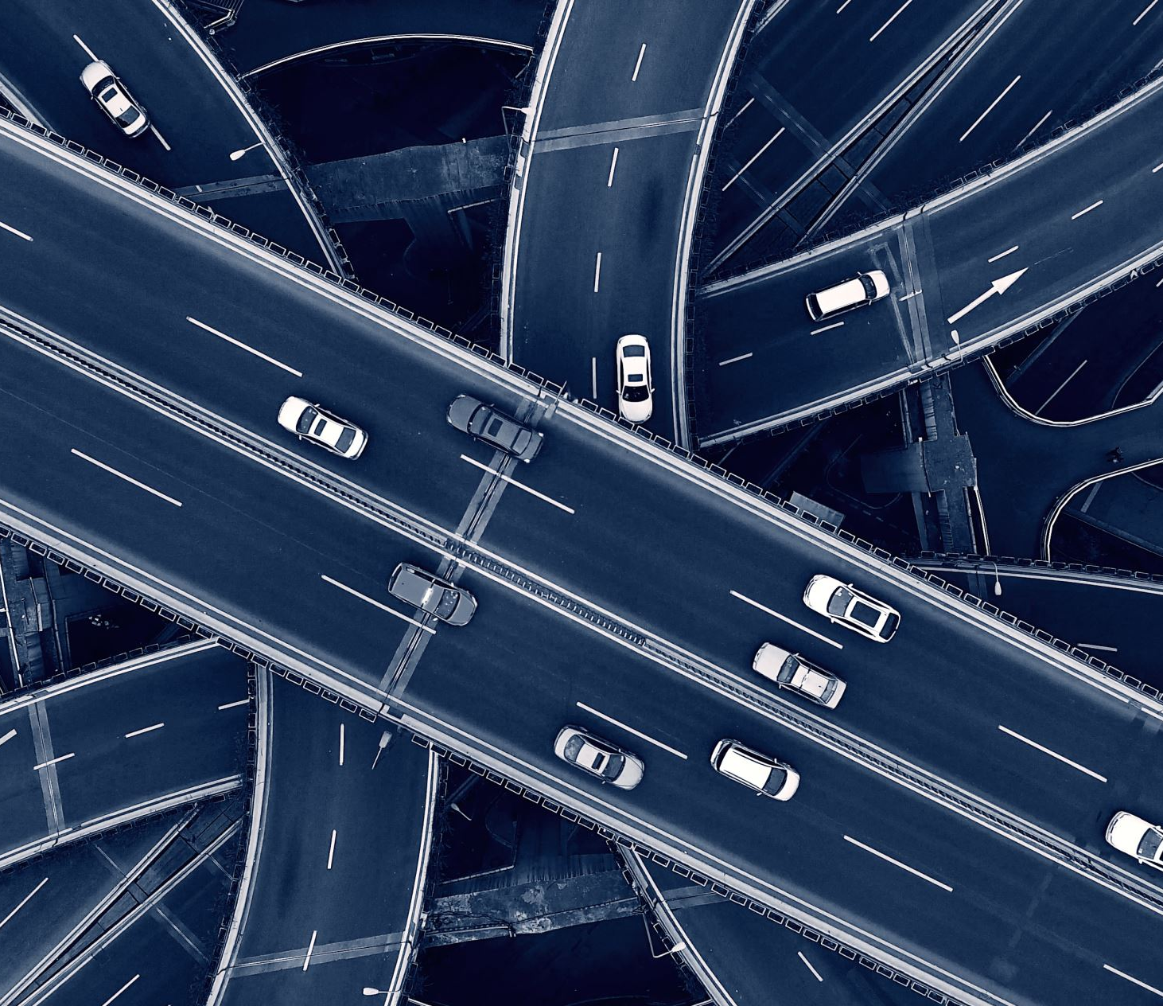
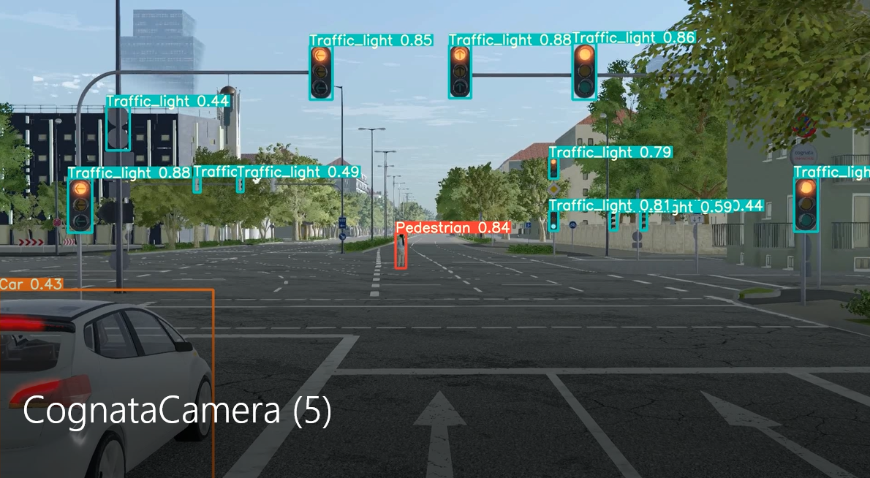
Detecting Region of Interest (ROI) in video stream for autonomous vehicles remote driving
P-2021-058

Slide 2
Students :
Omri Solomon, 311499883
Tomer Zahavi, 204366744
Supervisors:
Prof. Ofer Hadar
Mr. Raz Birman
Taking part in a collaboration with Andromeda Consortium

Slide 3
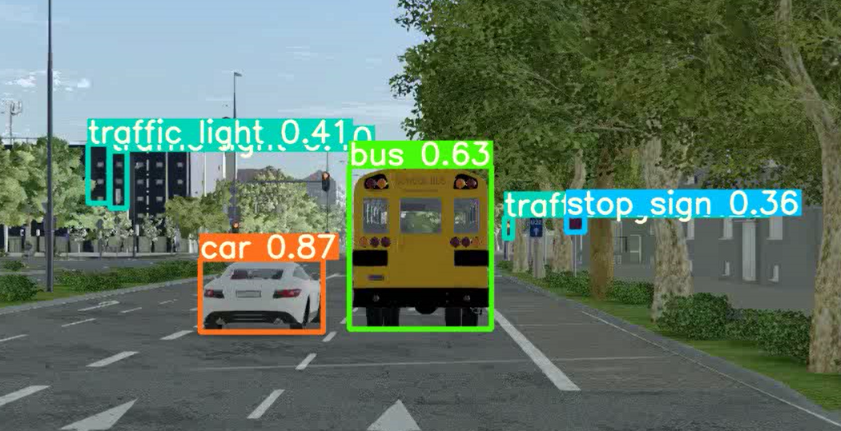
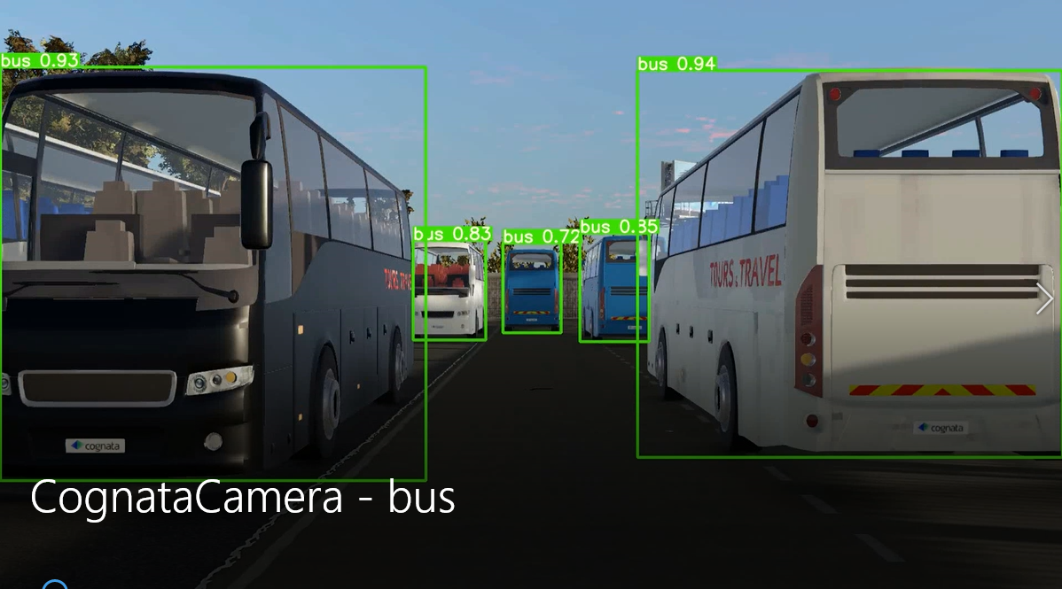
Introduction
The project is taking part of a collaboration with Andromeda consortium. BGU's part in this project is to create efficient means of delivering live streaming videos in real time.
Our part in this project is to:
Create a video dataset (of regular daily driving) using Cognata simulator.
Detect and classify important objects using our detection system ( based on CNN - Convolutional Neural Network – YOLOv5).
Compare the detection result to the actual ground truth ( which giving in the simulator output).
Train our network on our own simulation data of Traffic lights and to show we can make the network to classify real Traffic lights

Slide 4
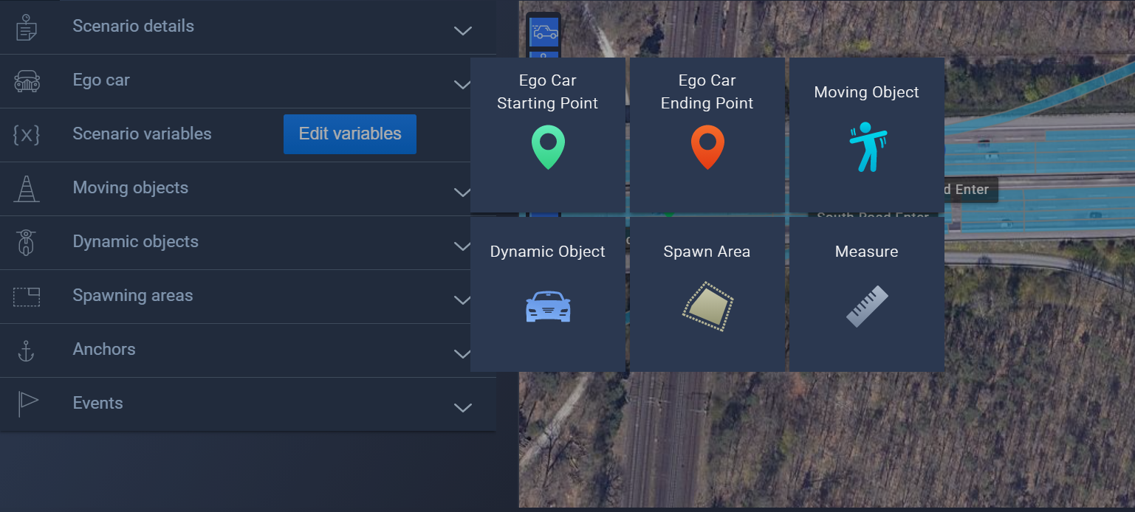
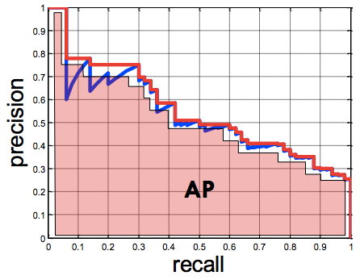
Technical Goals
Video dataset – Build our own driving videos dataset using Cognata simulator.
Detection – First, we will train our network to recognize the input objects we entered the simulator. Second, we will operate the YOLOv5 detection algorithm on the simulation's videos (Started on the YOLOv3 system).
Examination –After the detection stage we will examine the detection results with the actual ground truth (we will extract from Cognata simulator) in terms mean average precision.
Training – Train our network on our own simulation data of Traffic lights. Finally, Our goal is to show we can train a CNN network on simulation data and make it to be able to detect real traffic lights.

Slide 5
Block Diagram
Operate a detection system based on YOLOv5
Build dataset using Cognata and get the data for training
Train our network manually on traffic lights simulation data
Prove we can train on simulation data and detect in real life
Compare the results before and after training
Examine the detection results and compare to ground truth

Slide 6
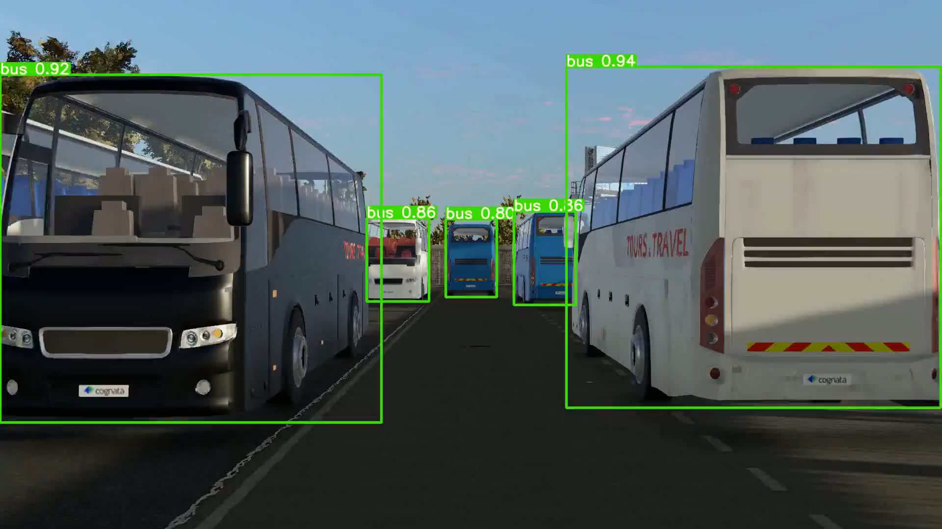
Preformed experiments -
Stage 1 - operate YOLOv5 : we succeeded to operate the latest version of YOLO detection system - the YOLOv5. Then, make the object detection on simulation videos we have created. The network in this stage (before training) is pre trained on some objects.

Slide 7
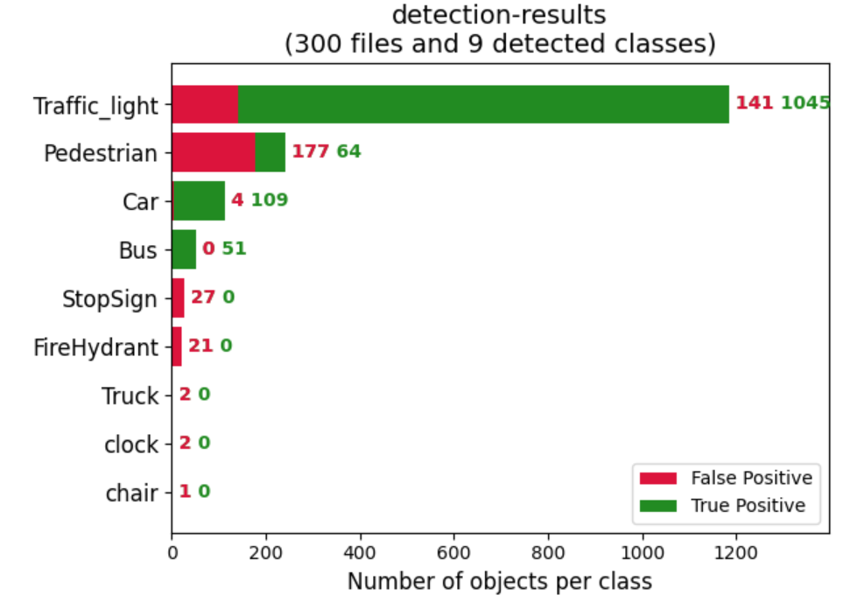
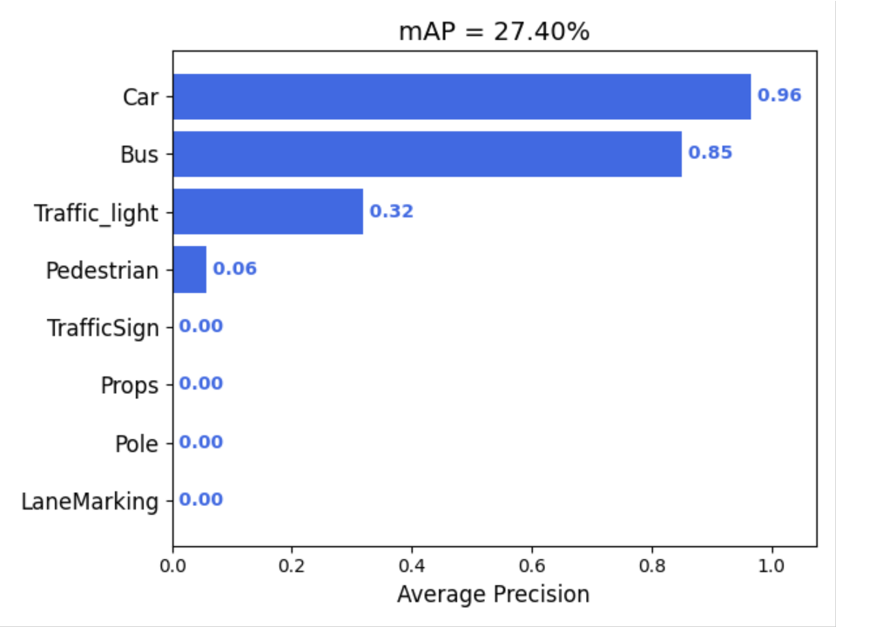
Preformed experiments -
Stage 2 – Examination : Extracted the detection results form our detection system, Extracted the ground truth objects data from Cognata, Compered the results and declared of the detection accuracy.
Example of the results for one simulation :
Detected | Ground truth | Class
51 (tp:51, fp:0) | 60 | Bus
113 (tp:109, fp:4) | 113 | Car
1186 (tp:1045, fp:141) | 3237 | Traffic light

Slide 8
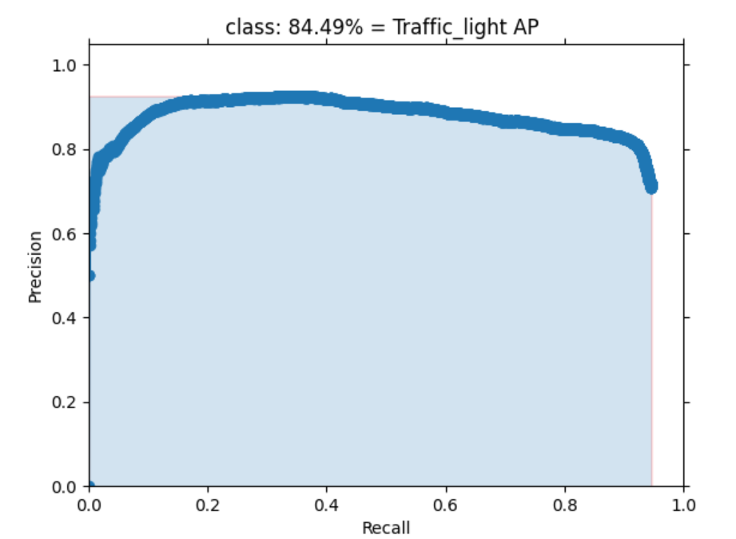
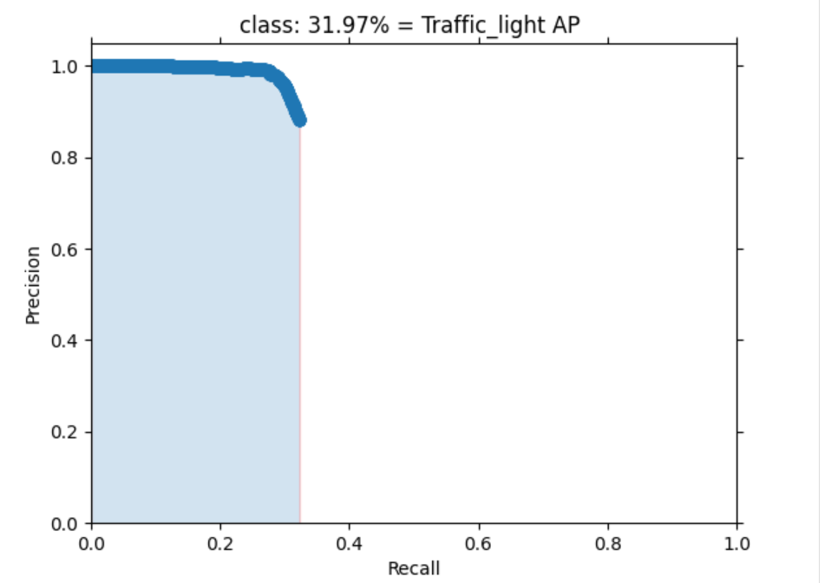
Preformed experiments -
Stage 3.1 – Training results: Traffic lights –In the training stage we based on Cognata simulation data (that we have created). For labeling we used the ground truth data. We trained our network on simulation Traffic lights data.
In the following we can see the results difference before and after the training:
After training – AP = 84.49%
Before training – AP = 31.97%

Slide 9
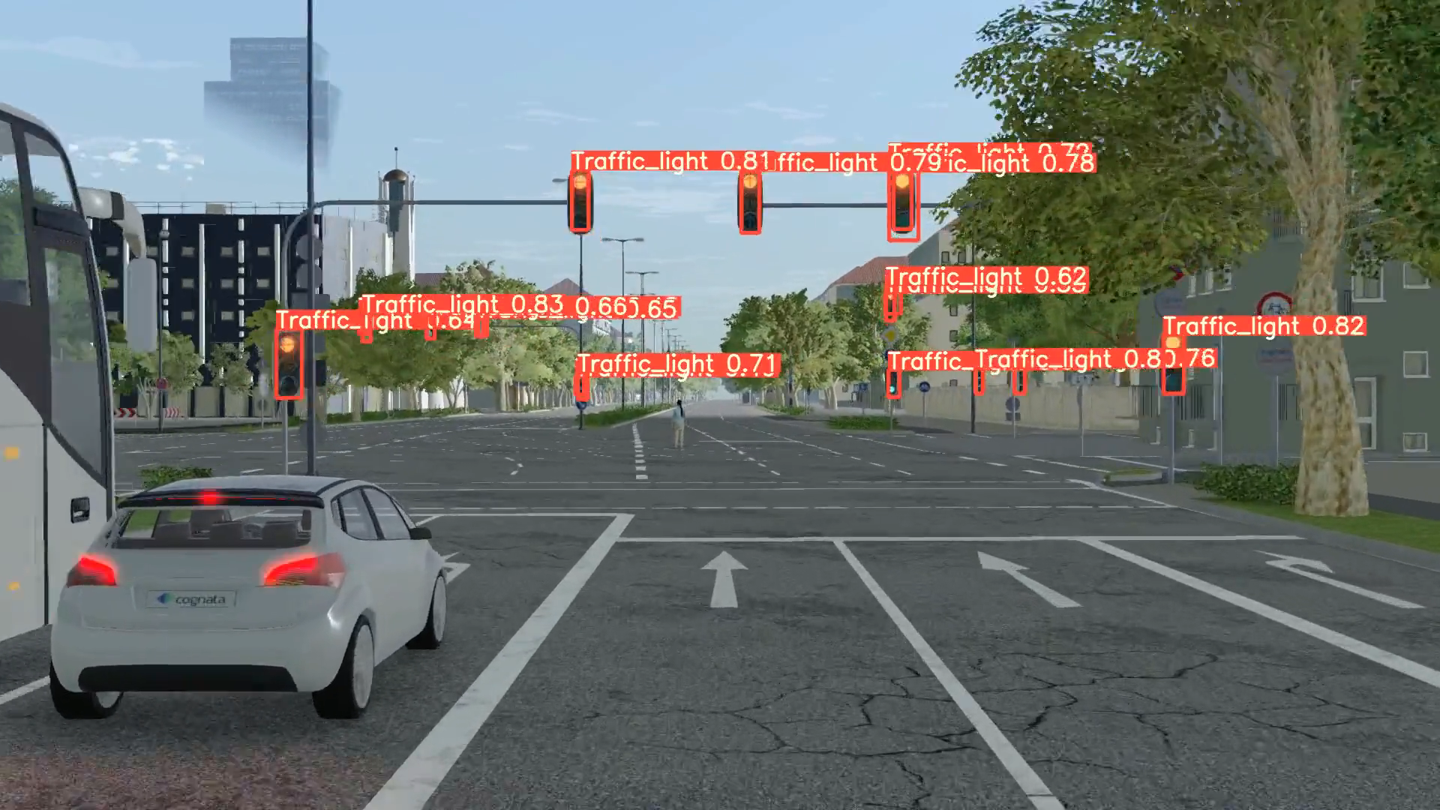
Results -
Traffic lights detection on our trained system –
these are the Traffic lights detection results after training on a simulation video.

Slide 10
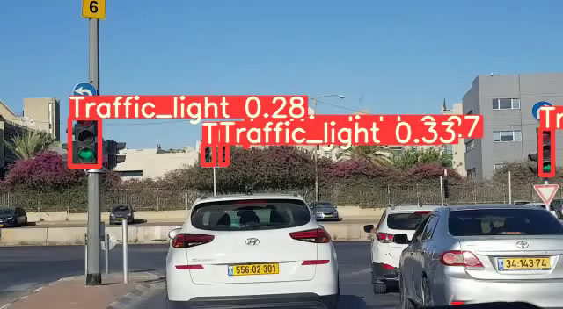
Results -
Traffic lights detection on our trained system - these are the Traffic lights detection results after training on real videos. We trained our system on simulation traffic lights, and It can detect and classify traffic lights on real videos.

Slide 11
Summarize Conclusions
Upgraded our detection algorithm from YOLOv3 to YOLOv5.
We operated a system that can examine the detection results (inputs the detection results and the ground truth data).
We trained the network on one class (Traffic lights) :
The detection results improved by 53% after the training.
These trained network we created, Can identify this one class (Traffic lights) on real life videos.
It is much easier to get the training data from simulation videos then labeling the objects in real life videos.
Main point : we can train a network on simulation data and use it to detect objects in real life.

